Slide 1

Number system
The Number System in computer

Slide 2
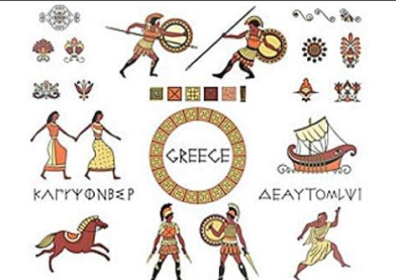
What is number system
A number system provides a consistent and organized method for writing, naming, and performing calculations with numbers is a way to represent and express numbers.
We use symbols(Shapes) in number system.
The kind of symbols the Egyptians used
Unary have single symbol
Binary have two Symbol
Ternary have three symbol etc.
And Decimal have Ten Symbol.
Hexadecimal have 16 symbol

Slide 3
Some key aspects of number systems include
1. Symbols
basic building blocks
decimal system uses digits 0 to 9
Roman numeral system uses letters like I, V, X, L, etc.
2. Base
Symbols variation or Number of shapes
Unary has base-1 single shape to representation the information e.g., 1=1,2=11,3=111 etc. i.e. This means it uses only one symbol (usually "1") to represent all numbers.
Binary has base-2 Two shape to representation the information e.g., 0=0,1=1,2=10,3=11,4=100 etc.
Decimal has base-10 Two shape to representation the information e.g., 0=0,1=1,2=2………,9 for 9 et

Slide 4
Place Values
The value a digit holds based on its position within the number or the importance or weight of each digit in a number based on its position
Each position in a number has a specific place value, increasing in value as we move left.
For example, in decimal, the rightmost position is the "one's place," then the "tens place," "hundreds place," and so on, each worth 10 times the previous one.
In binary, the rightmost position is the "one's place," then the "twos place," "fours place," "eights place," and so on, each worth 2 times the previous one.

Slide 5
Decimal place value
Place | Value | Example
Ones | 1 | 5
Tens | 10 | 50
Hundreds | 100 | 500
Thousands | 1,000 | 5,000
Ten Thousands | 10,000 | 50,000
Hundred Thousands | 100,000 | 500,000
Example:
Consider the number 357.
The 3 is in the hundreds place, so its value is 3 x 100 = 300.
The 5 is in the tens place, so its value is 5 x 10 = 50.
The 7 is in the ones place, so its value is 7 x 1 = 7.
Therefore, the entire number 357 can be written as 300 + 50 + 7.

Slide 6
Binary place values
Place value | Position | Value | Example
Ones | Rightmost | 2^0 | 1
Twos | One to the left | 2^1 | 2
Fours | Two to the left | 2^2 | 4
Eights | Three to the left | 2^3 | 8
Sixteens | Four to the left | 2^4 | 16
Thirty-twos | Five to the left | 2^5 | 32
Sixty-fours | Six to the left | 2^6 | 64
One-twenty-eights | Seven to the left | 2^7 | 128
Two-fifty-sixes | Eight to the left | 2^8 | 256
Binary: The place values of the number 101
Ones place: 1 * 2^0 = 1
Twos place: 0 * 2^1 = 0
Fours place: 1 * 2^2 = 4
Total value: 1 + 0 + 4 = 5

